Slide 1

Control statements part1
Kia babashahi Ashtiani

Slide 2
Outline
What are control statements?
Types of control statements.
If else statements.
Nested if else.

Slide 3
Control statmenets 1
Sometimes you need to make decisions.
Diamonds in the flow charts.
If condition p is true, then do action a1 else do action a2.
How do we translate these statements to a language that the IDE and the Machine understand?
While you see an even number ask the user to input more numbers.
Until the user has not inputted -5, keep on reading entries from the user.

Slide 4
Control structures (Statements)
Sequential execution: One after another
Transfer execution. The goto statement (AVOID AND PRETEND LIKE YOU HAVE NEVER SEEN THIS) .
Any Java code can be written using only three types of control structures:
Sequence structure
Selection structure
Repetition structure

Slide 5
Selection statements
Three types:
if: Checks for a condition if it is true it does something.
if else: Do something if the statement is true and something else if the statement is false.
switch case: preform multiple tasks based on the value of a particular statement/expression( Can be implemented using if else: Recommended).

Slide 6
Selection statements with bodies
When writing a selection statement such as if:
Check for the condition which is done in the parenthesize. ()
The scope of the statement: Based on the result you have obtained from the previous step preform one or a set of actions. What is between the: {}
Examples on the next slides.

Slide 7
Examples
You can only execute one command after the condition, for that no need for brackets the machine will only execute the immediate statement as a consequence of the evaluation of what is inside the ().
if(input=3)
System.out.println(“Number equals 3 will be only exce”);
You can group a set of actions to be preformed if the proposition was true.
if(input==4){
System.out.println(“input==4”);
Input+=1;
}
It does both the printing and it does input+=1;

Slide 8
num+=x
What is the += operator?
It is used to make coding even shorter. It works like this:
num=num+x;
You can have the same thing for –,*,%,/
num/=2 is translated to: num=num/2;

Slide 9
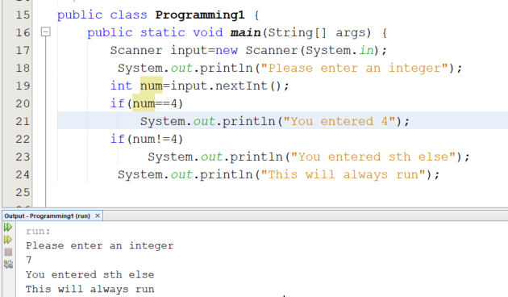
Code for if only

Slide 10
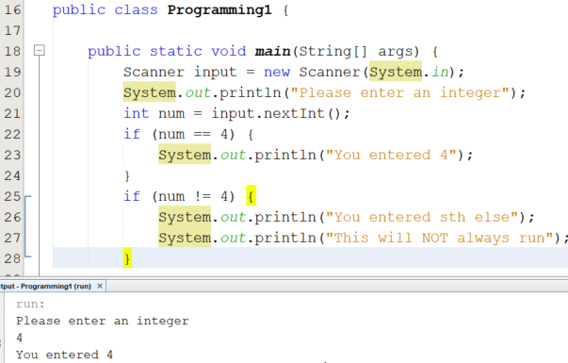
If with brackets

Slide 11
Good coding examples
It is better coding to add the brackets either ways to reduce the error rate.
It is important to respect the indentation.
Make sure to use meaningful variable names.
Make sure to use comments.

Slide 12
How to connect control statements
You can either terminate after the execution of one statement.
You can connect one entries ending to the beginning of other.
You can nest control statements inside each other.
You have seen examples of these in the flow chart section

Slide 13
If else
Just like a normal conversation : (A conditional statement)
If you see James tell him the news. Else, call him.
If n is divisible by two then it is an even number, Else n is odd .
A condition is evaluated and then a set of commands will be executed if the condition is true. If it is not the case that the condition is true another set of commands will be executed.

Slide 14
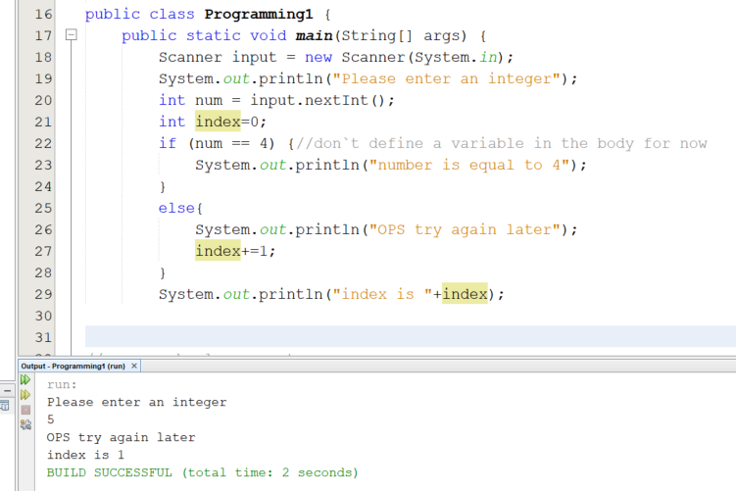
If else code

Slide 15
Nested if else
int rem=n%3;
How many possible values can rem take? (0,1,2) so three, right?
The user inputs an arbitrary number then you have to do the following:
Compute rem.
If rem=0 print the number is divisible by 3.
Else if rem=1 print rem is 1
Else print rem is 2.

Slide 16
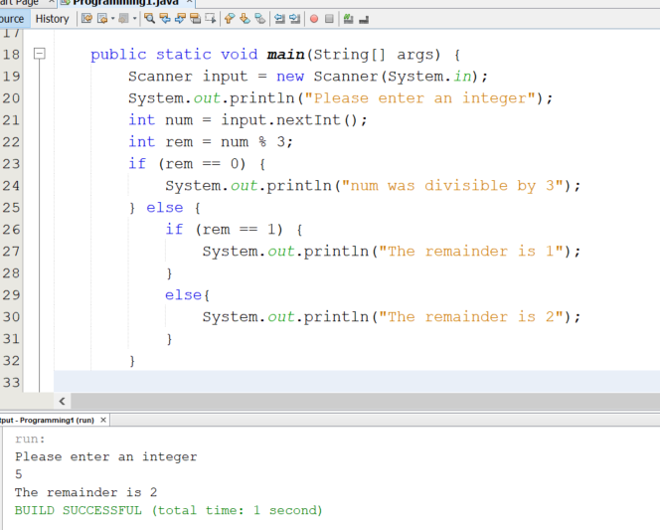
Code

Slide 17
Next time
More on selection structures.
Switch case
Local and global
While
Do while

